Slide 1





WALLET WISDOM HUB
Team Members:
Guide:
Sree Nikhitha K
Vamshi Krishna G
Venu Gopal
Jitesh Gupta
Umamaheswari R

Slide 2
Online Railway Reservation System
OUTLINE
Abstract
Problem Statement
Aims, Objective & Proposed System/Solution
System Design/Architecture
System Development Approach (Technology Used)
Algorithm & Deployment
Conclusion
Future Scope
References
Video of the Project
Notes:
These are the list of chapters that we are going to cover in these foundation codes. Those are chapter one what are AI and ML? chapter 2 applied Python programming in AI, and chapter 3 is exploratory data analysis for ML.

Slide 3
Abstract
Online Railway Reservation System
The Railway Reservation System facilitates the passengers to enquire about the trains available on the basis of source and destination, Booking and Cancellation of tickets, enquire about the status of the booked ticket, etc. The aim of case study is to design and develop a database maintaining the records of different trains, train status, and passengers . This project contains Introduction to the Railways reservation system It is the computerized system of reserving the seats of train seats in advanced. It is mainly used for long route. On-line reservation has made the process for the reservation of seats very much easier than ever before . In our country India, there are number of counters for the reservation these at and one can easily make reservations and get tickets. Then this project contains entity relationship model diagram based on railway reservation system and introduction to relation model.

Slide 4
Problem Statement
Online Railway Reservation System
In today's fast-paced world, the demand for efficient and convenient transportation systems is ever-increasing. Railway transportation remains a vital mode of travel for millions of people worldwide due to its reliability, affordability, and wide coverage. However, the traditional process of booking railway tickets often involves long queues at ticket counters and limited accessibility, leading to inconvenience for passengers.
The aim of this project is to develop an Online Railway Reservation System that revolutionizes the way passengers book and manage their train journeys. The system should provide a user-friendly interface accessible through web and mobile platforms, enabling passengers to effortlessly search for train routes, check seat availability, book tickets, and manage reservations from the comfort of their homes or on the go.

Slide 5
Aim and Objective
Online Railway Reservation System
Aim : The aim of the Railway Reservation System is to provide a convenient, efficient, and user-friendly platform for passengers to book train tickets, check seat availability, and manage their reservations seamlessly. By leveraging technology, the system aims to streamline the booking process, reduce queues at ticket counters, and enhance the overall passenger experience.
Objective:
Ease of Booking
Real-time Information:
Multiple Payment Options
Efficient Reservation Management
Accessibility and Compatibility

Slide 6
Proposed System/Solution
Online Railway Reservation System
The solution for an online railway reservation system encompasses various components and functionalities aimed at providing passengers with a seamless and convenient booking experience. Here's an overview of the key elements:
User Registration and Authentication:
Implement a secure user registration process requiring basic details such as name, email, and password.
Utilize email verification or OTP (One-Time Password) authentication to ensure the validity of user accounts.
Train Route Management:
Develop a comprehensive database of train routes, stations, schedules, and fare information.
Incorporate features for easy searching and filtering of routes based on origin, destination, date, and class.

Slide 7
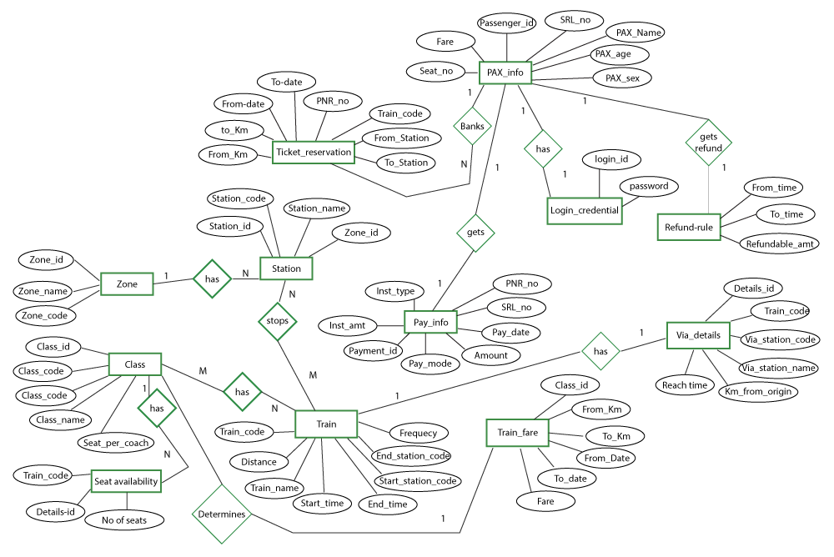
System Architecture
Online Railway Reservation System

Slide 8
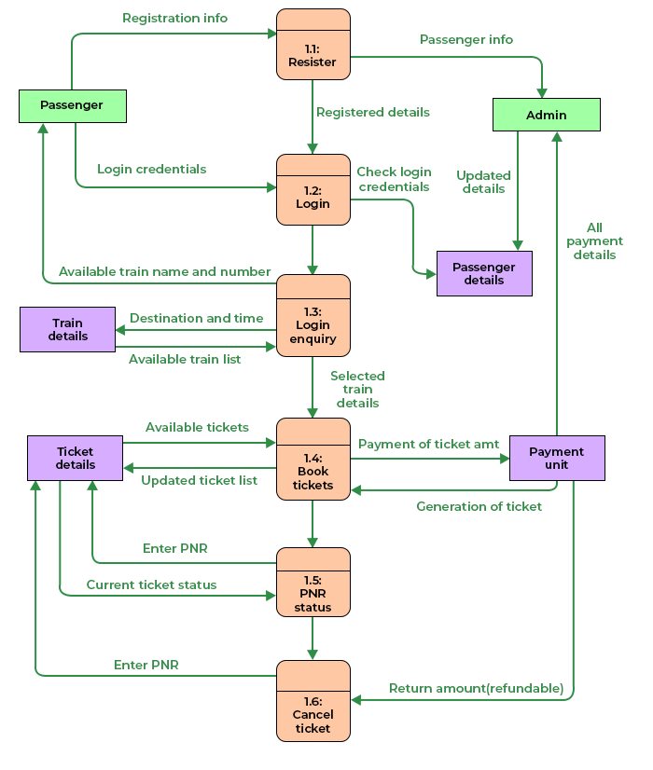
System Design
Online Railway Reservation System

Slide 9
System Development Approach
Online Railway Reservation System
Frontend Technologies:
HTML (Hyper Text Markup Language):
Utilized for structuring the website and creating the basic layout.
Responsible for defining the elements and content of web pages.
CSS (Cascading Style Sheets):
Employed for styling and formatting the HTML elements.
Ensures a visually appealing and consistent design across the website.
JavaScript:
Implemented for dynamic and interactive features on the client side.
Node.js: Empowers server-side JavaScript development, enabling the creation of scalable and high-performance web applications..

Slide 10
System Development Approach
Online Railway Reservation System
Backend Technologies:
PHP (Hypertext Preprocessor):
Used as the server-side scripting language to handle dynamic content.
Responsible for processing user input, managing database interactions, and executing server-side logic.
XAMPP Server:
XAMPP is a cross-platform web server solution that includes Apache, MySQL, PHP, and Perl.
Apache is the web server responsible for serving web pages.
MySQL is the relational database management system (RDBMS) used for storing and retrieving data.
PHP interacts with the Apache server to dynamically generate content and communicate with the MySQL database.
phpMyAdmin:
A web-based tool for managing MySQL databases.
Used for database administration, including creating, modifying, and querying the database.

Slide 11
Algorithm & Deployment
Online Railway Reservation System
Payment Processing Algorithm:
This algorithm manages the payment transaction securely.
It interfaces with the chosen payment gateway to authorize and process payments using encryption and secure communication protocols.
Cancellation Algorithm:
This algorithm handles ticket cancellation requests.
It updates the reservation status in the database, releases the reserved seats, and processes any refund if applicable according to the cancellation policy.
Search Algorithm:
This algorithm enables users to search for trains based on specified criteria such as origin, destination, date, and class.
Sorting Algorithms for Search Results:
When displaying search results to users, sorting algorithms can be used to arrange trains based on criteria such as departure time, duration, or price to help users find the most suitable option easily.

Slide 12
Deployment
Online Railway Reservation System
Deployment in the context of software development refers to the process of making a developed application or system available and accessible for use. It involves the transition from a development environment to a production environment, where the software can be utilized by end-users. It involves the following :
Database Setup
Server Configuration
Security Measures
Maintenance
User Access

Slide 13
Conclusion
Online Railway Reservation System
In conclusion, the online railway reservation system represents a significant advancement in modernizing the booking process, improving passenger convenience, and enhancing the overall efficiency of railway operations. Through the systematic development approach outlined and the integration of future technologies and trends, the system is poised to revolutionize the way passengers interact with railway services.
The system's user-centric design, seamless booking experience, and robust security measures ensure that passengers can easily search for train routes, check seat availability, and book tickets with confidence. Real-time information, secure payment integration, and efficient reservation management further contribute to a hassle-free booking process.

Slide 14
Future Scope
Online Railway Reservation System
The future of online railway reservation holds significant potential for innovation and enhancement, driven by advancements in technology, changing passenger expectations, and evolving industry trends. Here are some potential future directions and opportunities for improvement in the online railway reservation domain:
Artificial Intelligence (AI) and Machine Learning (ML) Integration:
Implement AI-powered chatbots to provide personalized assistance, answer queries, and guide users through the booking process.
Utilize ML algorithms for predictive analysis of passenger demand, enabling dynamic pricing strategies and optimized resource allocation.
Voice-Activated Interfaces:
Introduce voice-activated booking interfaces leveraging natural language processing (NLP) technologies, making the reservation process more intuitive and accessible.

Slide 15
Online Railway Reservation System
References :
Railway management system, database mini project
1. KL University Department of Computer Science Engineering Course code -15CS2007 Database Systems II B.Tech – 2nd Semester Academic Year 2016-2017 Project Based Lab ON RAILWAY RESERVATION SYSTEM Submitted by Section – S3 Batch No: 6 Student ID Student Name Department 150030407 K. Shashank Reddy CSE 150030936 T. Jai Sai Chand CSE
2. K L University DEPARTMENT OF COMPUTER SCIENCE ENGINEERING (DST-FIST Sponsored Department) This is to certify that the course based project entitled “RAILWAY RESERVATION SYSTEM” is a bonafide work done by K.Shashank Reddy(150030407), T. Jai Sai Chand(150030936) in partial fulfilment of the requirement for the award of degree in “BACHELOR OF TECHNOLOGY in Computer Science Engineering” during the academic year 2016-2017. Faculty In Charge Head of the Department DR. D. Rajeswara Rao Prof. Srikanth Vemuru CERTIFICATE
3. DEPARTMENT OF COMPUTER SCIENCE ENGINEERING (DST-FIST Sponsored Department) We hereby declare that this project based lab report entitled “RAILWAY RESERVATION SYSTEM” has been prepared by us in partial fulfillment of the requirement for the award of degree “BACHELOR OF TECHNOLOGY in COMPUTER SCIENCE ENGINEERING” during the academic year 2016- 2017. We also declare that this project based lab report is of our own effort and it has not been submitted to any other university for the award of any degree. Date: Place: Vaddeswaram Name Student ID K. Shashank Reddy 150030407 T. Jai Sai Chand 150030936 DECLARATION
Notes:
Reference
These are the references for this session.
15

Slide 16
Online Railway Reservation System
Thank you!
Notes:
thank you very much for joining this PPT, keep learning.
16

Slide 17
Online Railway Reservation System
Video of the Project:
https://youtu.be/1z723lVMNP8
Notes:
thank you very much for joining this PPT, keep learning.
17

